Slide 1
Matrix Multiplication with Photonic Simulation
Team: A1_14

Slide 2
Goals from Sprint 1
Research and Acquire Necessary Hardware
Decide what simulation software(s) to utilize to achieve MVP
Start writing Verilog Files to load onto FPGA
Research current photonic hardware that is available for purchase by the public

Slide 3
Splitting UP
Original MVP : “Simulation and test benchmarks showing the difference between FPGA and Optical Processor”
Modified MVP: “Simulate photonic processor performing a successful matrix multiplication”
FPGA vs Photonics
FPGA
A1_09
Photonics
A1_14

Slide 4
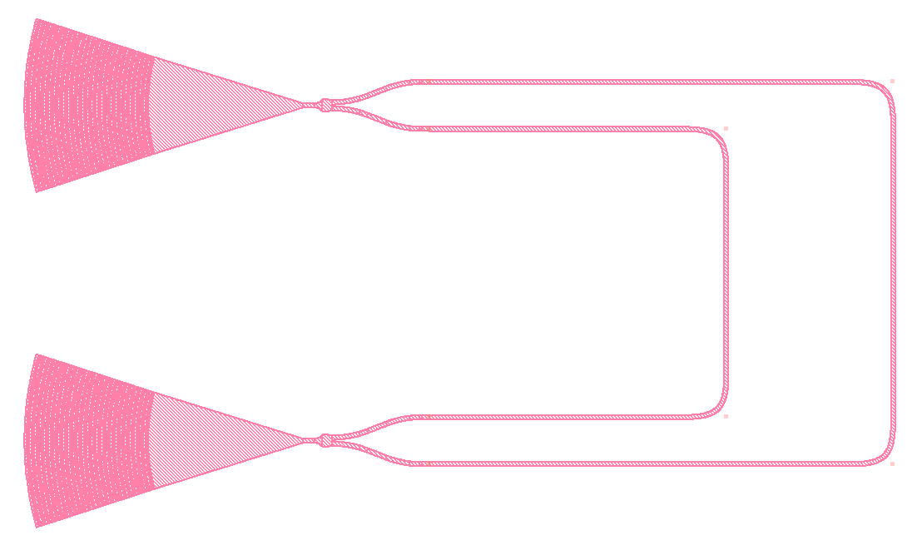
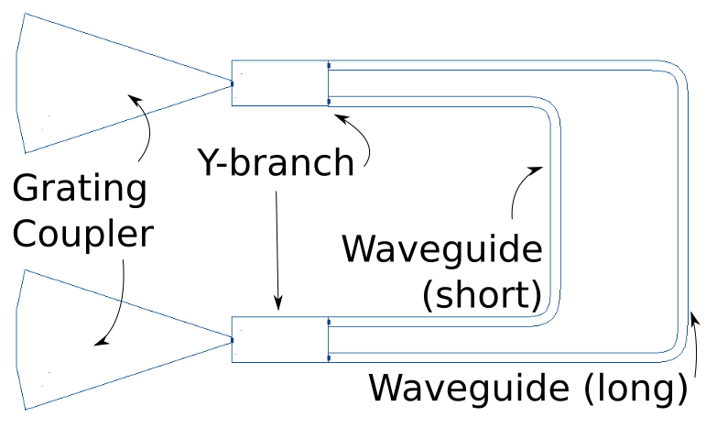
Photonic Simulation
Mach-Zehnder Interferometer
Simphony
Available on the SCC
Available through Github
Python
Noxim
Available through Github
C++

Slide 5
Goals for Sprint 3
Simulate a simple circuit with simphony
Simulate same circuit with Noxim
Compare results
Decide if continuing with both simulation softwares or just one
Create shared project folder on SCC
Successfully run chosen simulation software in SCC

